Slide 1
Introduction to Programming

Slide 2

From code.org

Slide 3
Always code as if the guy who ends up
maintaining your code is a violent
psychopath who knows where you live.
-- John Woods

Slide 4
“The computer programmer is a creator of
universes for which he alone is the lawgiver.
No playwright, no stage director, no emperor,
however powerful, has ever exercised such
absolute authority to arrange a stage or
field of battle and to command such unswervingly
dutiful actors or troops.”
--Joseph Weizenbaum

Slide 5
Programming is the art of doing one
thing at a time.
-- Michael C. Feathers

Slide 6
Our greatest glory is not in never falling,
but in rising very time we fall.
-- Confucius

Slide 7
“This course will seem overwhelming the first
week or two. But taken one step at a time,
with careful study and attention to detail, you
will do well.”
-- me

Slide 8
Why would you want to learn to program?
The sheer joy of making things – being creative
The pride in making something that is useful to other people
The fascination of solving complex problems
Figuring out how to do something you’ve never done before
Making a dumb machine do smart things
Earning a lot of money
This class is required …

Slide 9
Comment from a student …
“I want a career, not just a degree”

Slide 10
“I love those moments, often wee quiet hours of the morning,
when you begin to see what is forming... It is like being there
at the wheel with the clay in your hands. It is the joy of creating
something beautiful, something purposeful, something delightful,
something to share... Sharing in the joy of creation, software
development can be a means of self-expression where we give
substance to our abstract thoughts, ideas, and feelings.”

Slide 11
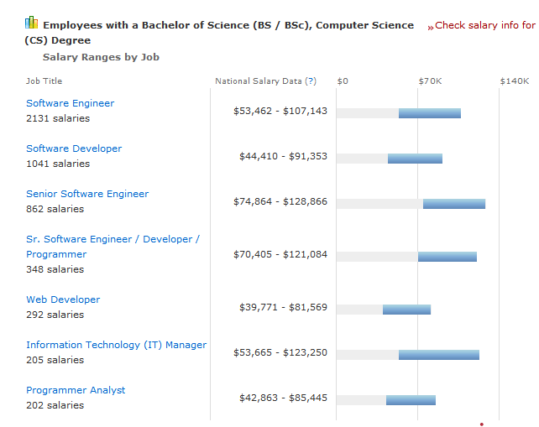

Slide 12
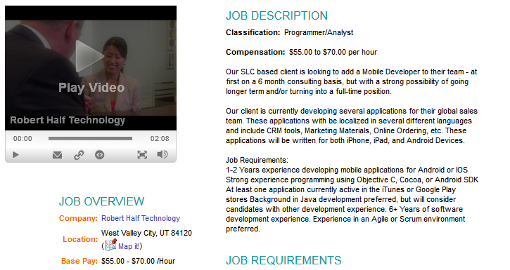
$70/hr * 40 hrs/week * 52 weeks/yr = $145,600/year

Slide 13
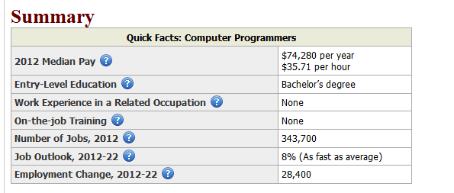
From the United Stated Department of Labor, 2012

Slide 14
What fields do programmers work in?

Slide 15
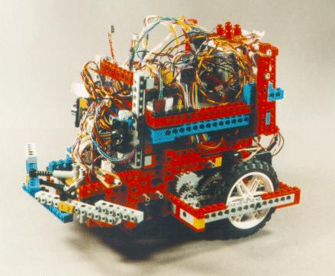
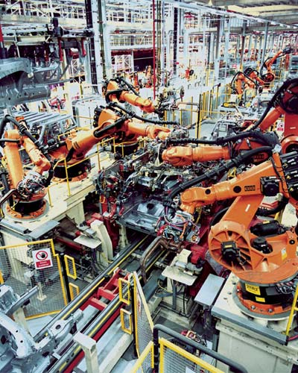
Robotics

Slide 16
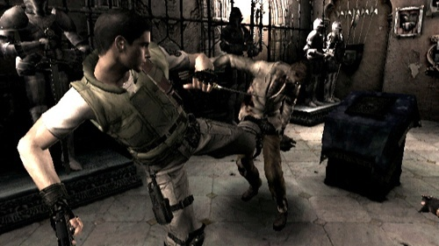
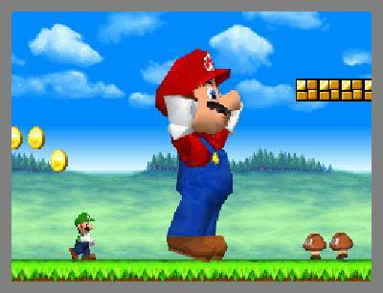
Games

Slide 17

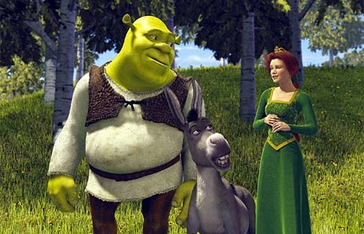
Computer Graphics/Animation

Slide 18
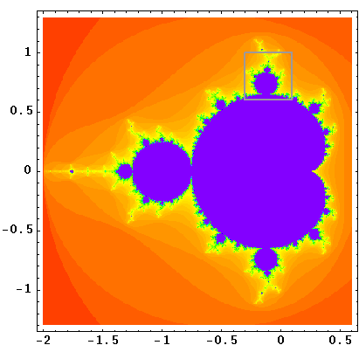
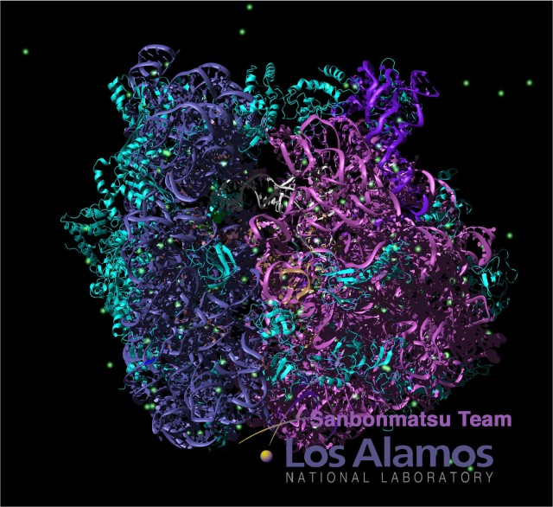
Science/Math

Slide 19
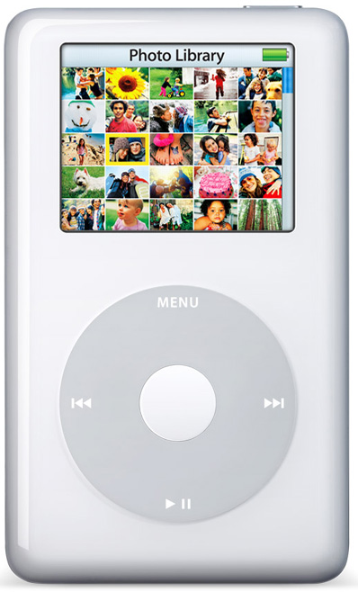
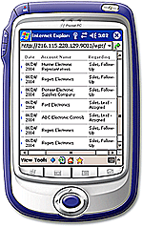
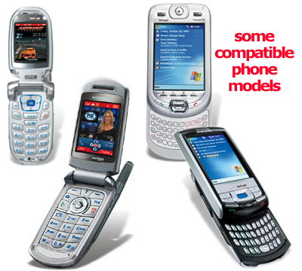
Entertainment/Communication

Slide 20


Web Applications

Slide 21
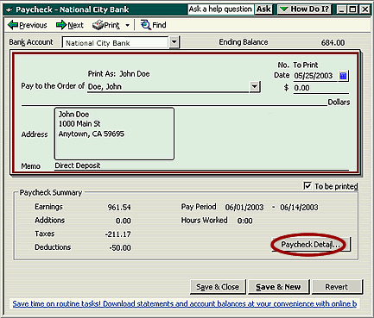
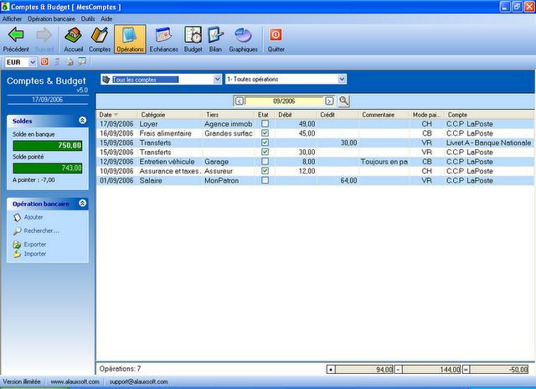
Business/Finance

Slide 22
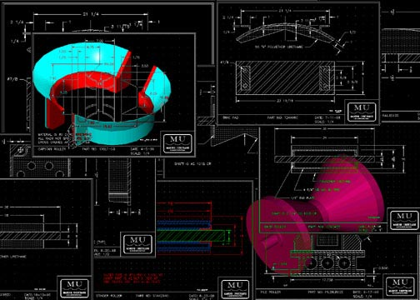
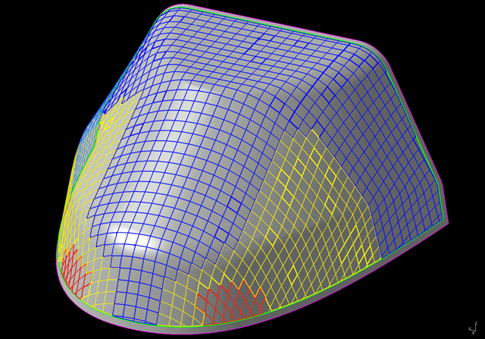
Engineering

Slide 23
Learning to program requires
Time
Patience
Good language skills
The ability to think abstractly
Good math skills
The ability to solve problems
Practice – Program, program, program
A sense of curiosity

Slide 24
Learning to Program Takes Time
Researchers have shown that learning to do anything well
(playing the piano, painting, playing tennis, etc) takes
about 10 years. Learning to be a good programmer is no
different.
To become proficient at programming
Practice
Practice
Practice …

Slide 25
Math Skills are Important
The rise of mathematics is heating up the job market for
luminary quant's, especially at the Internet powerhouses
where new math grads land six-figure salaries and
rich stock deals. Tom Leighton, an entrepreneur and applied
math professor at Massachusetts Institute of Technology,
says: "All of my students have standing offers at Yahoo!
and Google. Top mathematicians are becoming a new global
elite. It's a force of barely 5,000, by some guesstimates,
but every bit as powerful as the armies of Harvard University
MBAs who shook up corner suites a generation ago.
Business Week Cover Story
January 23, 2006

Slide 26
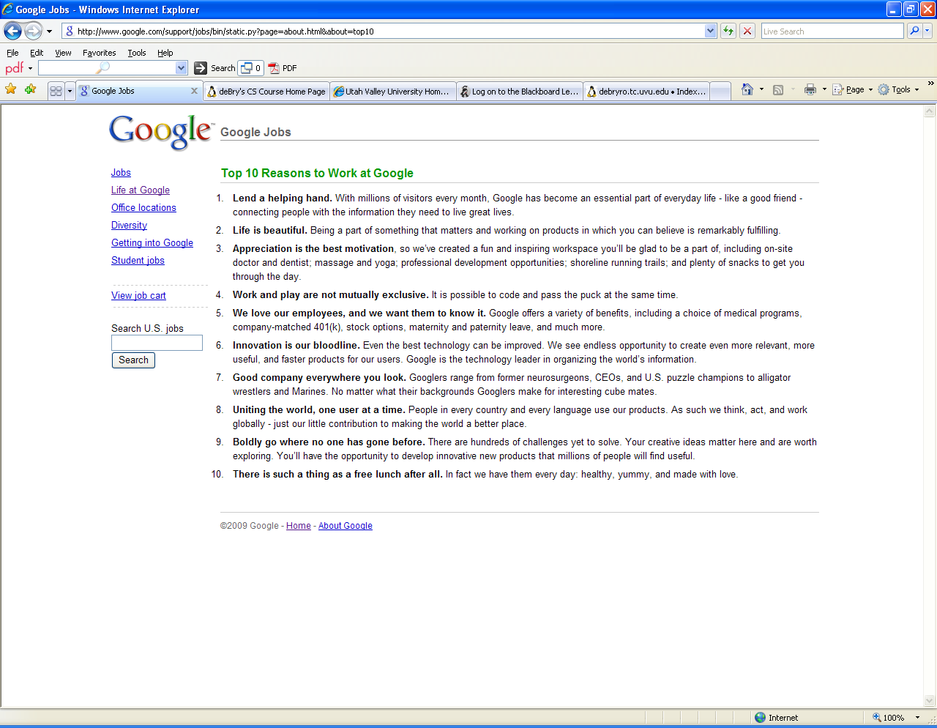

Slide 27
What do Programmers Do?
They talk to their customers
They talk to their peers
They discuss problems
They think a lot
They write a lot
They design solutions to problems
They write code
They debug code
They refactor code
They test code
They document code
They fix code
. . .

Slide 28
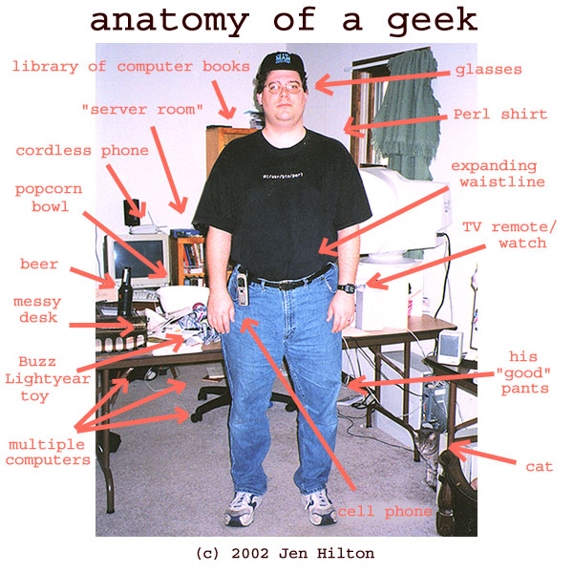

Slide 29
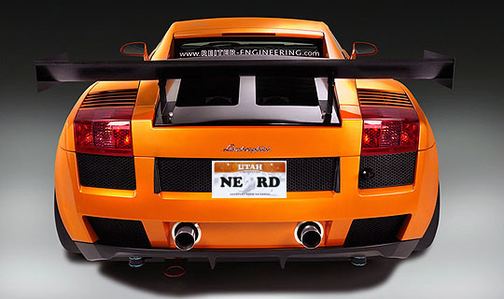

Slide 30
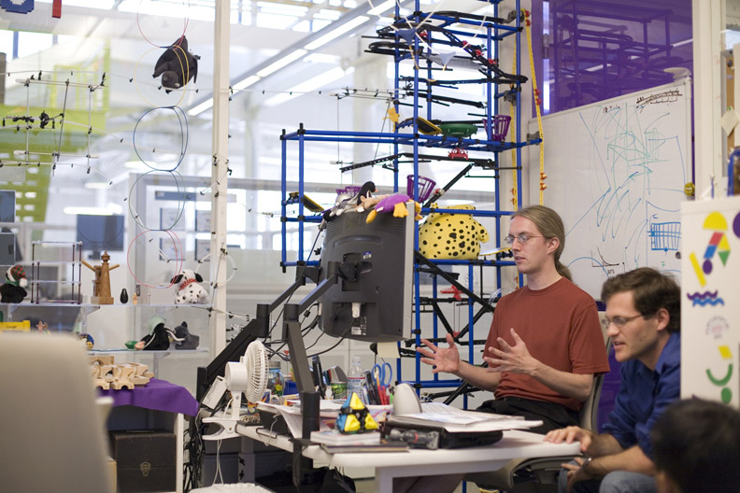
Google Offices

Slide 31
Programming Tools
The computer
The operating system
The code editor
The compiler
The debugger
Integrated
Development
Environment
Problem solving skills
Language skills

Slide 32
The Computer
Data
Segment
CPU
Program Counter
Instruction Register
Code
Segment
Memory
General Purpose Registers
Status Registers
Stack
Arithmetic and
Logic Unit
Heap

Slide 33
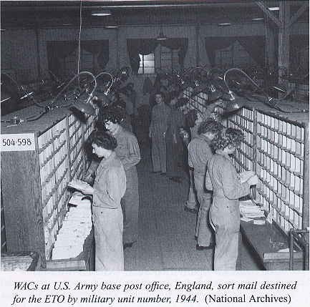

Slide 34
The Computer
Data
Segment
Program Counter
Instruction Register
Code
Segment
General Purpose Register
Status Registers
Stack
Arithmetic and
Logic Unit
Heap

Slide 35
The Computer
Watch how the computer
adds two numbers together …
Data
Segment
Program Counter
Instruction Register
Code
Segment
General Purpose Register
Status Registers
Stack
Arithmetic and
Logic Unit
Heap

Slide 36
The Computer
The program to be executed is
stored in the code segment.
The data is stored in the data
segment. The program counter
points to the next instruction
to be executed.
address
24
28
32
10
12
--
Data
Segment
Program Counter
60
60
64
68
72
ld r1, 24
ld r2, 28
add r1, r2
sto r1, 32
Instruction Register
Code
Segment
Register r1
Register r2
Stack
Arithmetic and
Logic Unit
Heap

Slide 37
The Computer
address
24
28
32
10
12
--
Data
Segment
Program Counter
60
60
64
68
72
ld r1, 24
ld r2, 28
add r1, r2
sto r1, 32
Instruction Register
Code
Segment
Register r1
Register r2
Stack
Arithmetic and
Logic Unit
Heap

Slide 38
The Computer
address
24
28
32
10
12
--
Data
Segment
60
64
68
72
ld r1, 24
ld r2, 28
add r1, r2
sto r1, 32
Program Counter
60
ld r1, 24
Instruction Register
Code
Segment
Register r1
Register r2
Stack
Arithmetic and
Logic Unit
Heap

Slide 39
The Computer
address
24
28
32
10
12
--
10
Data
Segment
Program Counter
60
60
64
68
72
ld r1, 24
ld r2, 28
add r1, r2
sto r1, 32
Instruction Register
ld r1, 24
Code
Segment
Register r1
Register r2
Stack
Arithmetic and
Logic Unit
Heap

Slide 40
The Computer
address
24
28
32
10
12
--
10
Data
Segment
Program Counter
64
60
64
68
72
ld r1, 24
ld r2, 28
add r1, r2
sto r1, 32
Instruction Register
ld r1, 24
Code
Segment
Register r1
10
Register r2
Stack
Arithmetic and
Logic Unit
Heap

Slide 41
The Computer
address
24
28
32
10
12
--
10
Data
Segment
Program Counter
64
60
64
68
72
ld r1, 24
ld r2, 28
add r1, r2
sto r1, 32
ld r2, 28
Instruction Register
ld r1, 24
Code
Segment
Register r1
10
Register r2
Stack
Arithmetic and
Logic Unit
Heap

Slide 42
The Computer
address
24
28
32
10
12
--
10
12
Data
Segment
Program Counter
64
60
64
68
72
ld r1, 24
ld r2, 28
add r1, r2
sto r1, 32
Instruction Register
ld r2, 28
Code
Segment
Register r1
10
Register r2
Stack
Arithmetic and
Logic Unit
Heap

Slide 43
The Computer
address
24
28
32
10
12
--
10
Data
Segment
Program Counter
68
60
64
68
72
ld r1, 24
ld r2, 28
add r1, r2
sto r1, 32
Instruction Register
ld r2, 28
Code
Segment
Register r1
10
Register r2
12
Stack
Arithmetic and
Logic Unit
Heap

Slide 44
The Computer
address
24
28
32
10
12
--
10
Data
Segment
Program Counter
68
60
64
68
72
ld r1, 24
ld r2, 28
add r1, r2
sto r1, 32
Instruction Register
ld r2, 28
add r1, r2
Code
Segment
Register r1
10
Register r2
12
Stack
Arithmetic and
Logic Unit
Heap

Slide 45
The Computer
address
24
28
32
10
12
--
10
Data
Segment
Program Counter
68
60
64
68
72
ld r1, 24
ld r2, 28
add r1, r2
sto r1, 32
Instruction Register
add r1, r2
Code
Segment
Register r1
10
10
12
Register r2
12
Stack
22
Arithmetic and
Logic Unit
Heap

Slide 46
The Computer
address
24
28
32
10
12
--
10
Data
Segment
Program Counter
68
60
64
68
72
ld r1, 24
ld r2, 28
add r1, r2
sto r1, 32
Instruction Register
add r1, r2
Code
Segment
Register r1
10
Register r2
12
Stack
22
Arithmetic and
Logic Unit
Heap

Slide 47
The Computer
address
24
28
32
10
12
--
10
Data
Segment
Program Counter
72
60
64
68
72
ld r1, 24
ld r2, 28
add r1, r2
sto r1, 32
Instruction Register
ld r1, 24
Code
Segment
sto r1, 32
Register r1
22
Register r2
12
Stack
Arithmetic and
Logic Unit
Heap

Slide 48
The Computer
address
24
28
32
10
12
10
Data
Segment
Program Counter
72
60
64
68
72
ld r1, 24
ld r2, 28
add r1, r2
sto r1, 32
Instruction Register
sto r1, 32
Code
Segment
Register r1
22
22
Register r2
12
Stack
Arithmetic and
Logic Unit
Heap

Slide 49
The Operating System
Manages the memory in the computer
Manages how and when programs are executed
Manages the devices attached to the computer
and lots of other stuff …

Slide 50
The code editor provides a way for
The programmer to create and edit the
source code text for his or her program.
Editors provide tools to cut and paste source
Code text, move between source code files,
and do many other editing tasks.

Slide 51
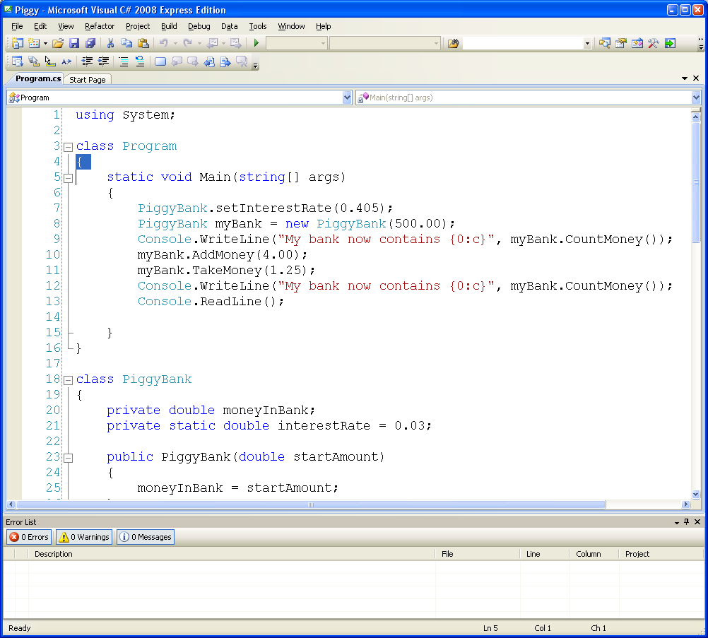

Slide 52
The Compiler
static void Main( )
{
int a = 5;
int b = 27;
. . .
source code
compiler

Slide 53
Ξϖνϖψι
Λκλιλ
Ηϕφκκφολ98
Οπ09κιϕ
Πλολλκ
Ετχ
…
source code
compiler
Intermediate
Language

Slide 54
Interpreter
source code
compiler
Intermediate
Language
Ξϖνϖψι
Λκλιλ
Ηϕφκκφολ98
Οπ09κιϕ
Πλολλκ
Ετχ
…
code segment
data segment
stack segment
.exe

Slide 55
code segment
data segment
stack segment
program A
loader
program B
program C
the heap is left over
memory, not being used
by any program. It is
managed by the O/S.
the heap
reserved for
operating
system

Slide 56
Visual C# Express Edition is an
Integrated Development Environment (IDE).
It includes
* a code editor
* a compiler
* a debugger
* and other development tools

Slide 57
If you have not completed lab #1,
be sure to complete it and turn it in
before 11:59pm on the due date.

Slide 58
Questions?

